Slide 1
The Anatomy of
The MySQL Query Optimizer
Presented by Michael “Monty” Widenius
and Igor Babaev

Slide 2
The Lost World of The MySQL Query Optimization
Presented by Michael “Monty” Widenius
and Igor Babaev

Slide 3
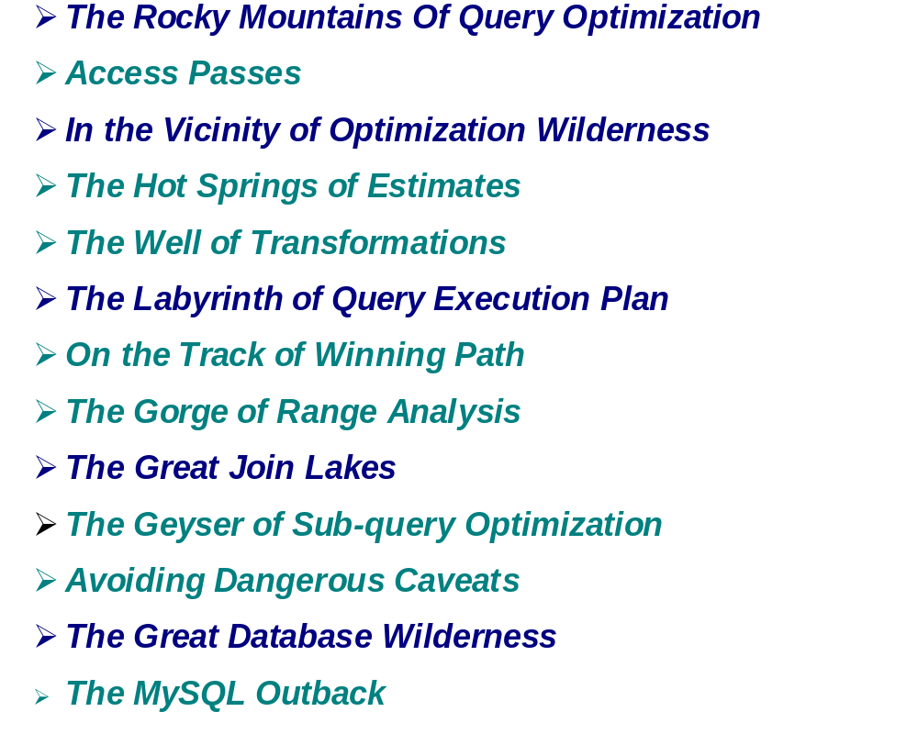

Slide 4
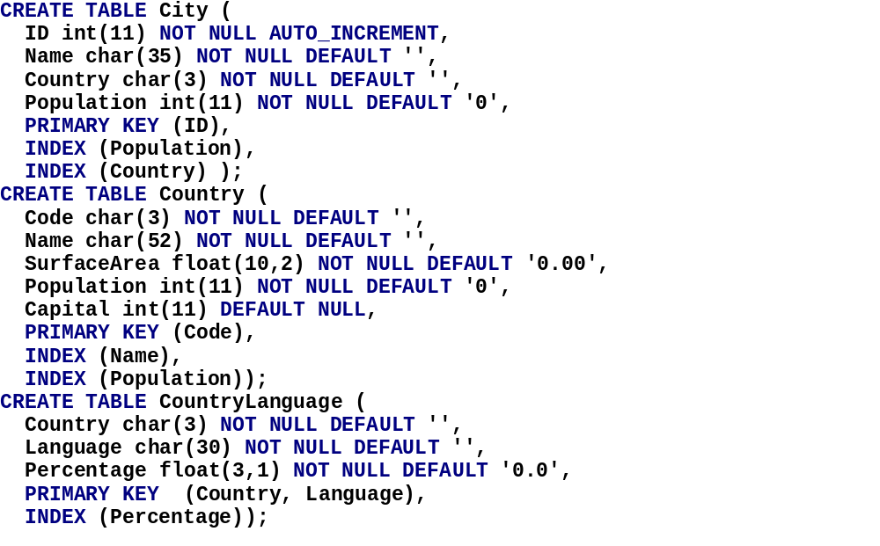

Slide 5
The Rocky Mountains Of Query Optimization:
The role of the optimizer in query processing

Slide 6
Access Passes:
Table access methods and query execution plans

Slide 7
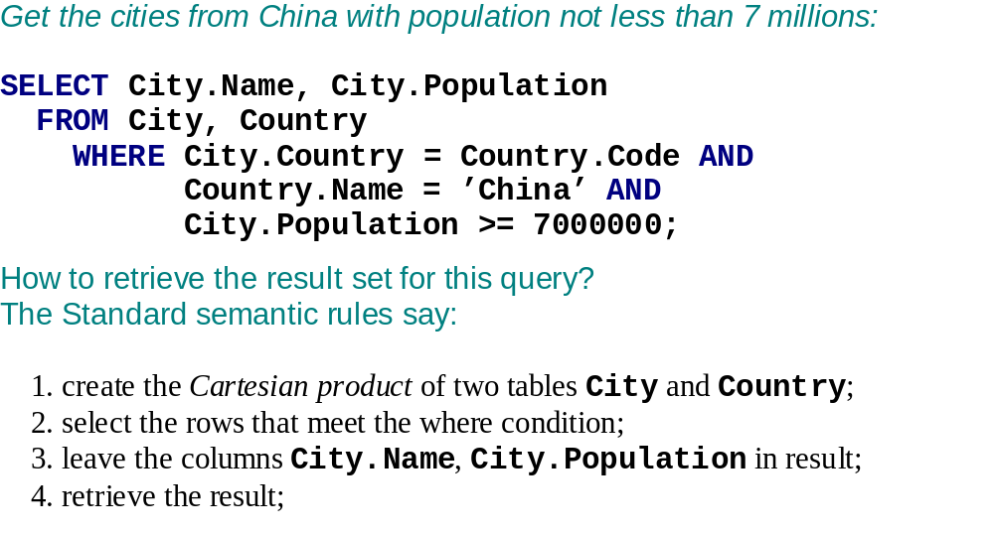

Slide 8
1
Euro
Cartesian product
Coin | Dice
Heads | 1
Heads | 2
Heads | 3
Heads | 4
Heads | 5
Heads | 6
Coin | Dice
Tails | 1
Tails | 2
Tails | 3
Tails | 4
Tails | 5
Tails | 6

Slide 9
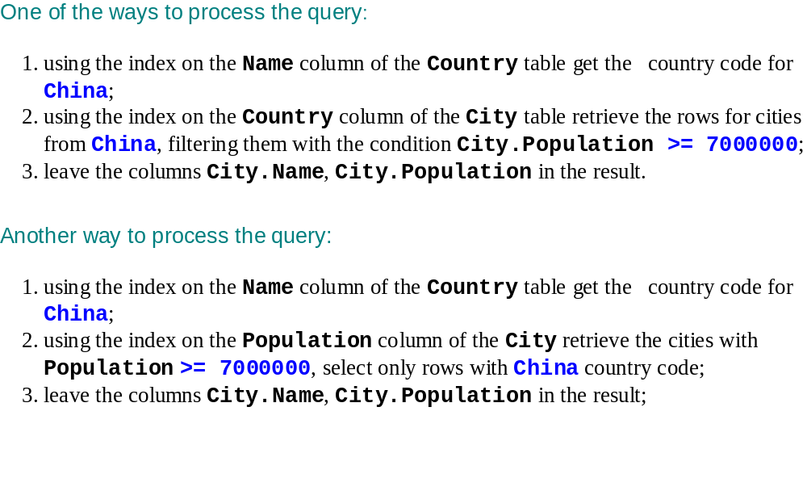

Slide 10
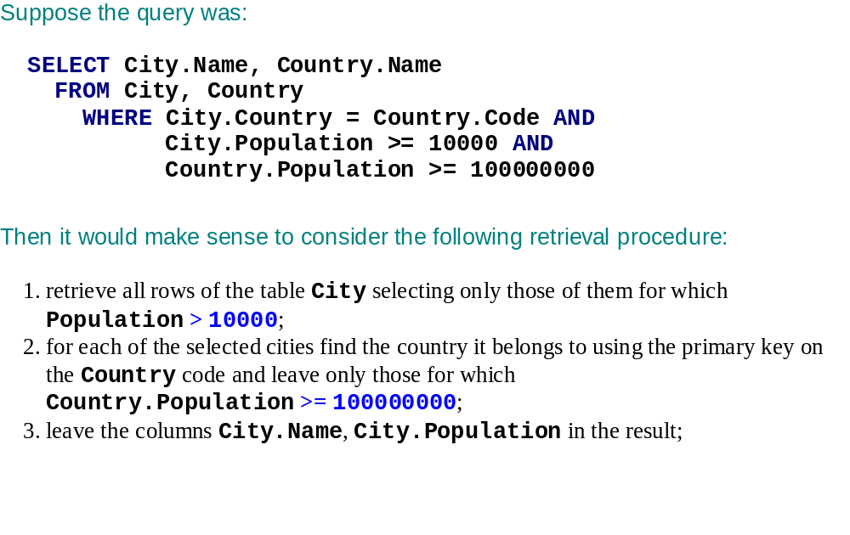

Slide 11
In the Vicinity of Optimization Wilderness:
How the optimizer interacts with other major parts: parser and database engines

Slide 12
Parsing
Query Validation
Optimizer
Query Transformations
Execution Plan Search
Execution Plan Compilation
Execution

Slide 13
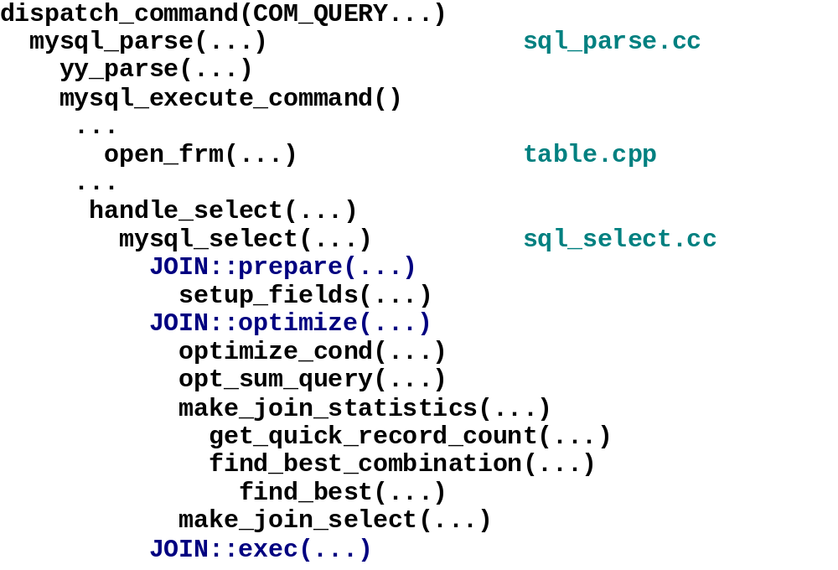

Slide 14
Landmark 1.
The Hot Springs of Estimates:
Cost-based optimization
Cost functions
Predicting number of records in the result set

Slide 15
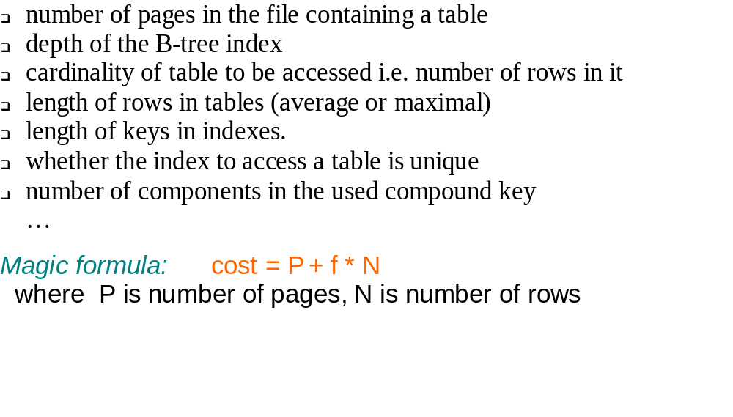

Slide 16
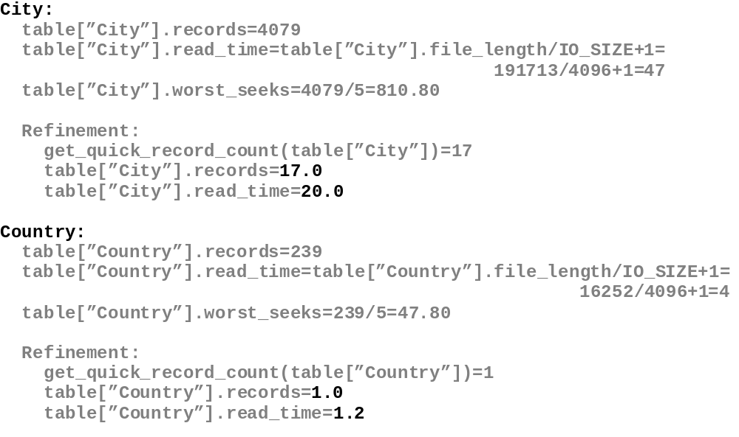

Slide 17
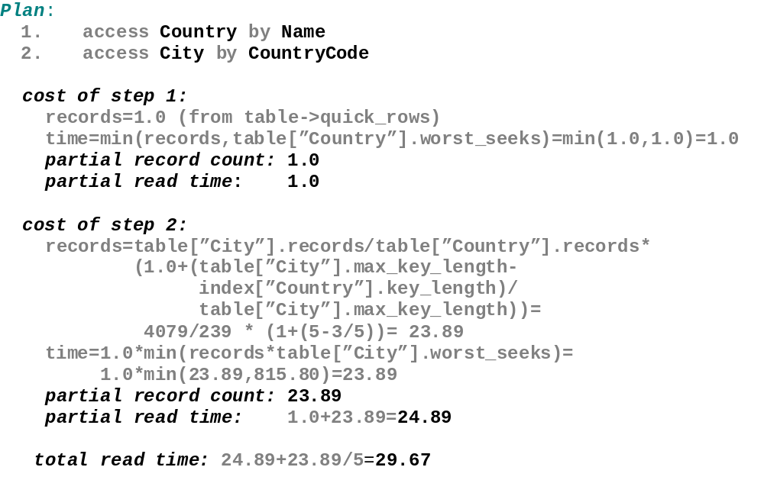

Slide 18
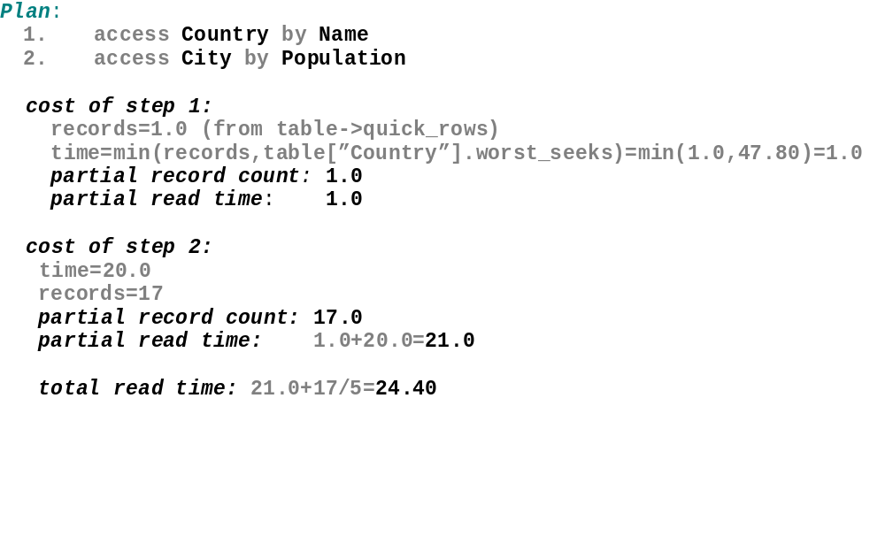

Slide 19
Landmark 2.
The Well of Transformations:
Query transformations
Condition propagation and partial evaluation of sub-expressions
Min/Max optimization

Slide 20
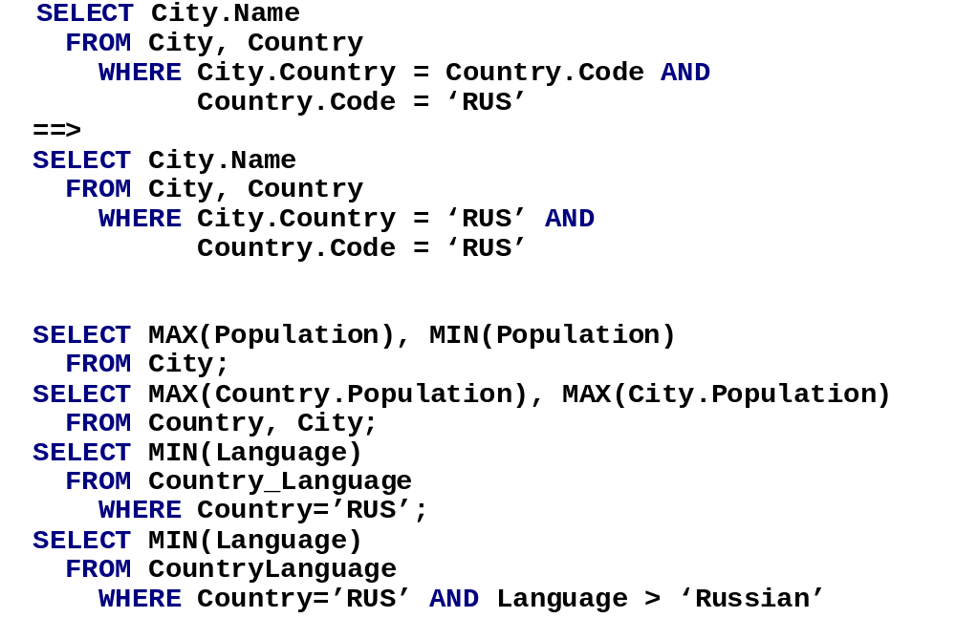

Slide 21
Onsite Excursion.
The Labyrinth of Query Execution Plan:
Looking for an optimal execution plan
The search space
The strategies to narrow it
User control over the search process

Slide 22
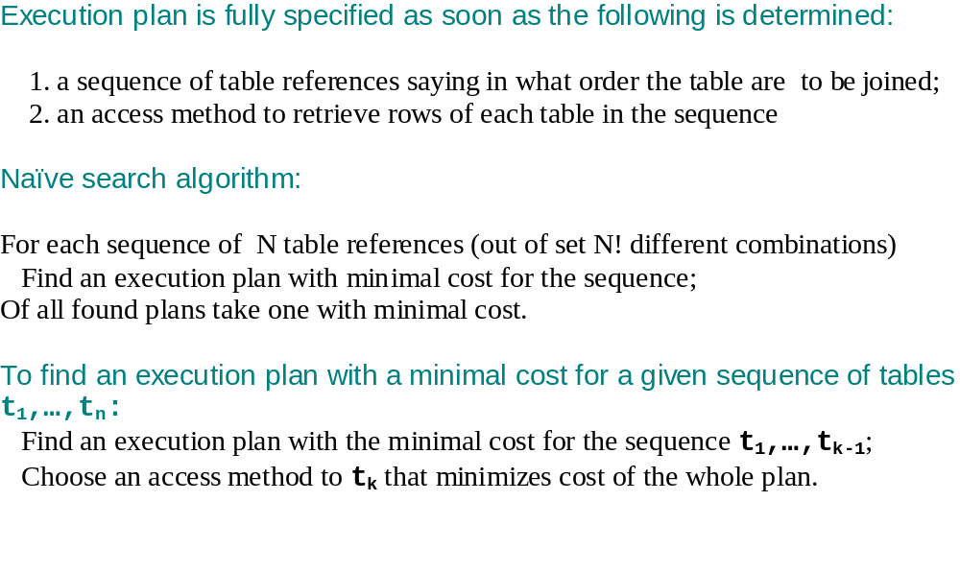

Slide 23
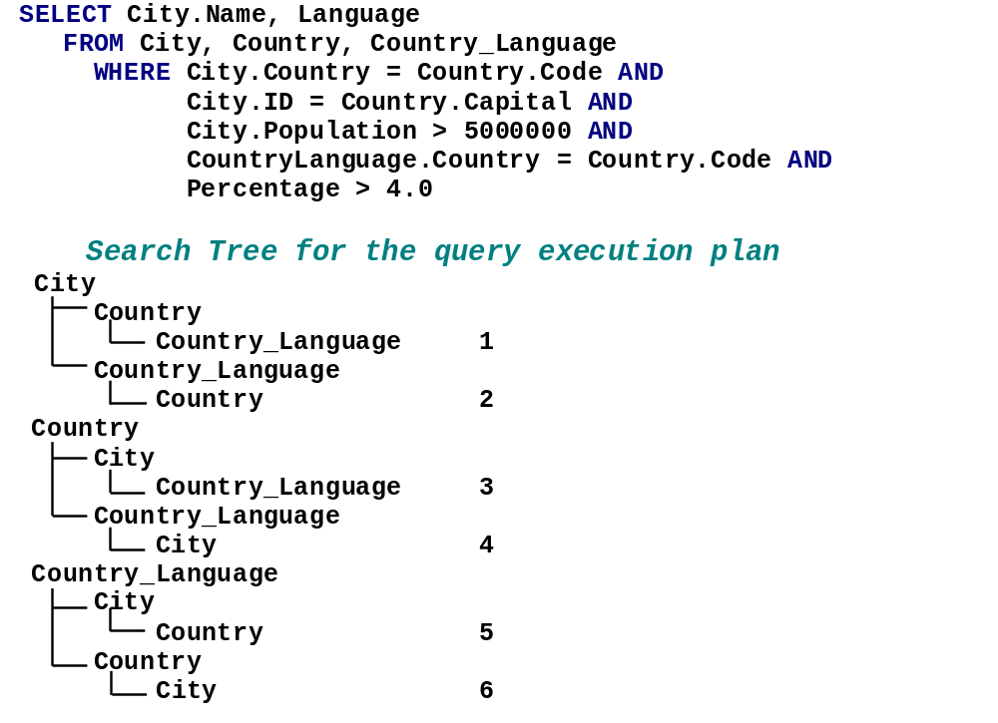

Slide 24
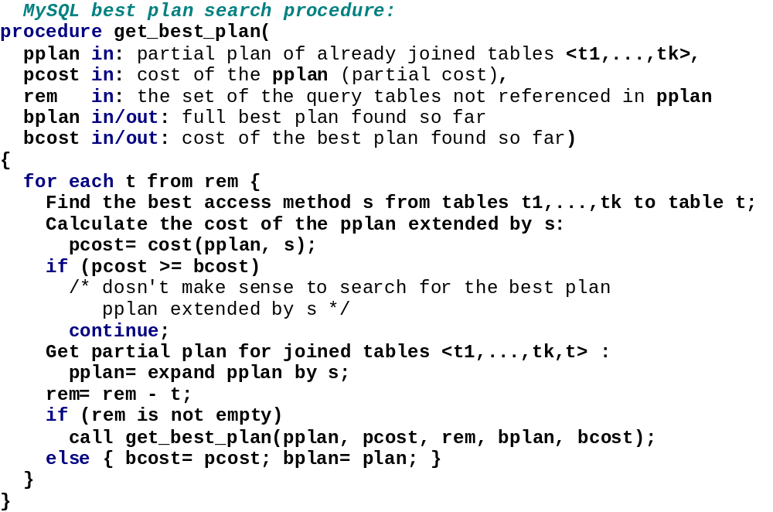

Slide 25
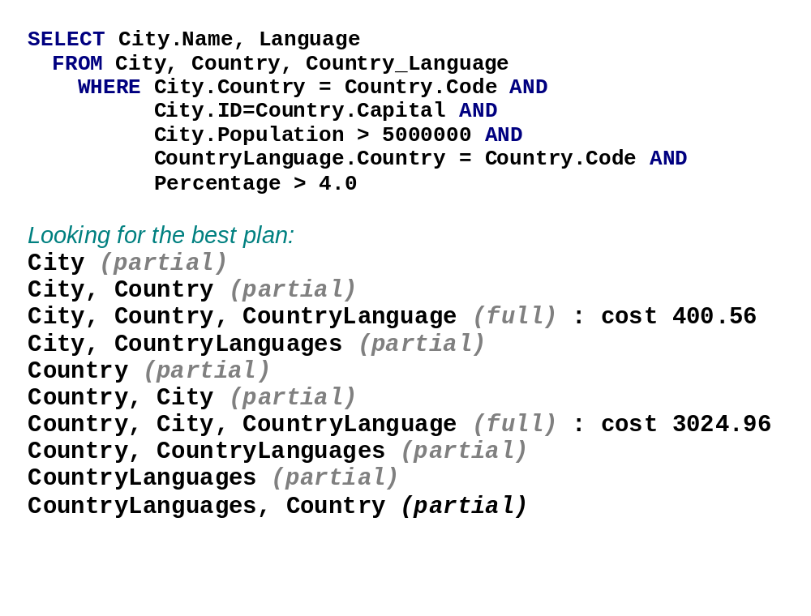

Slide 26
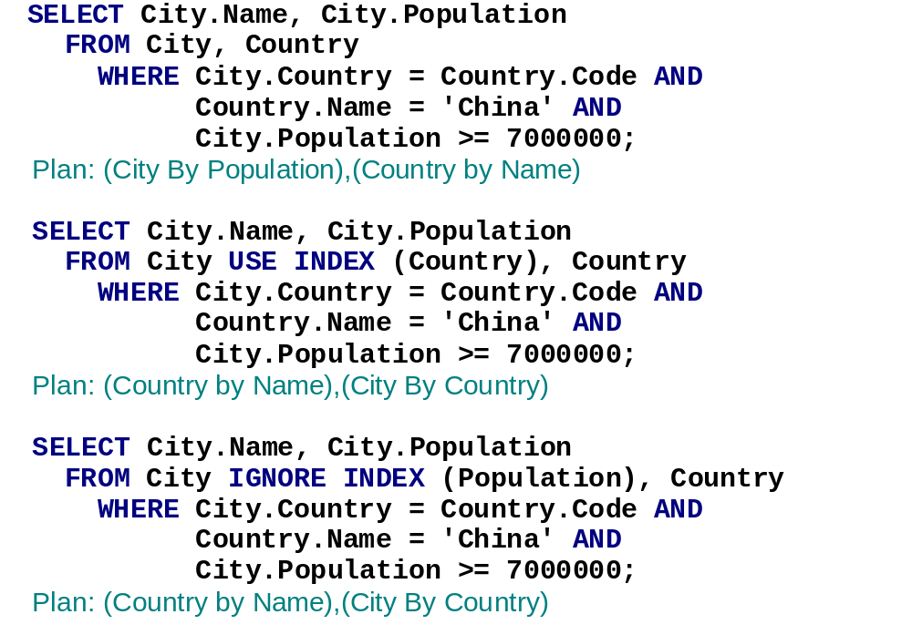

Slide 27
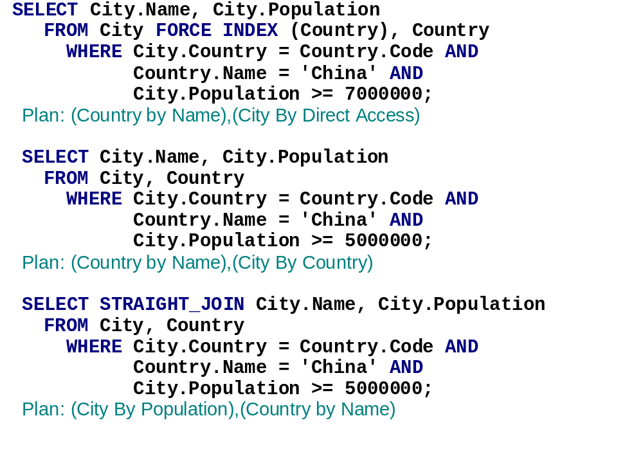

Slide 28
Travel Booklet.
On the Track of the Winning Path:
EXPLAIN operator
Internal representation of an execution plan

Slide 29
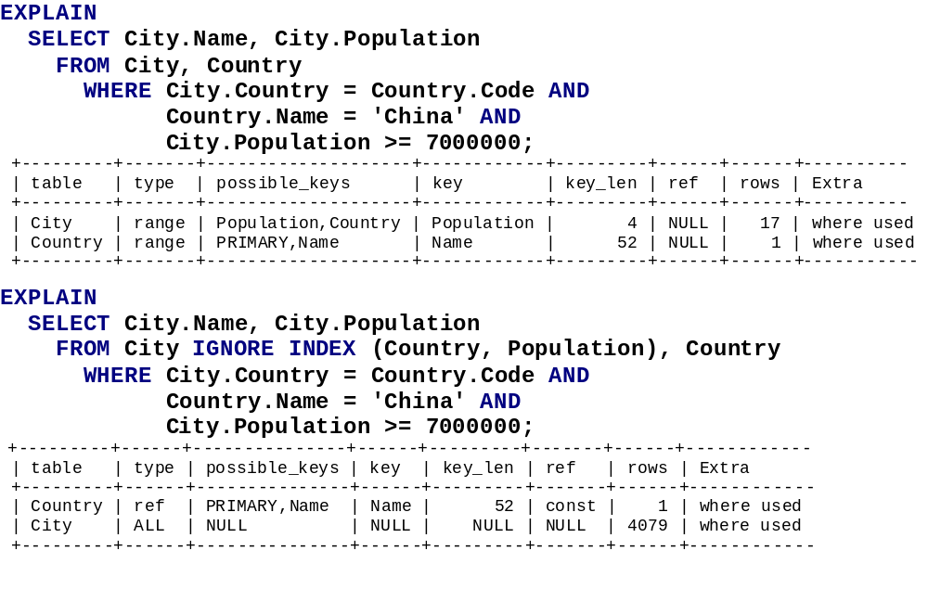

Slide 30
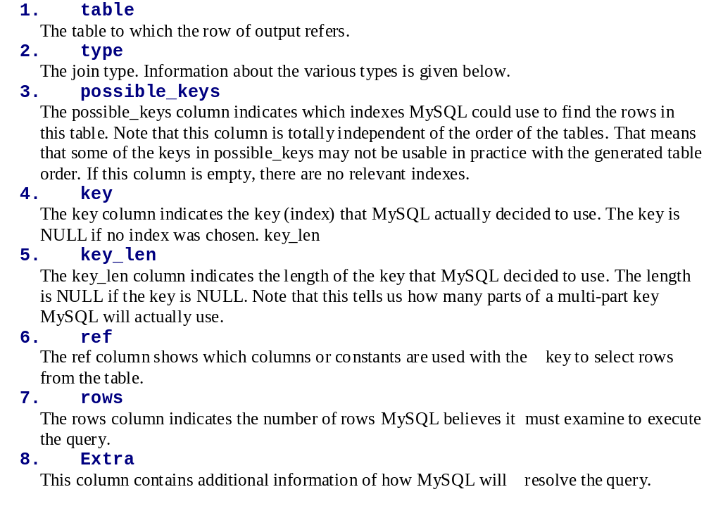

Slide 31
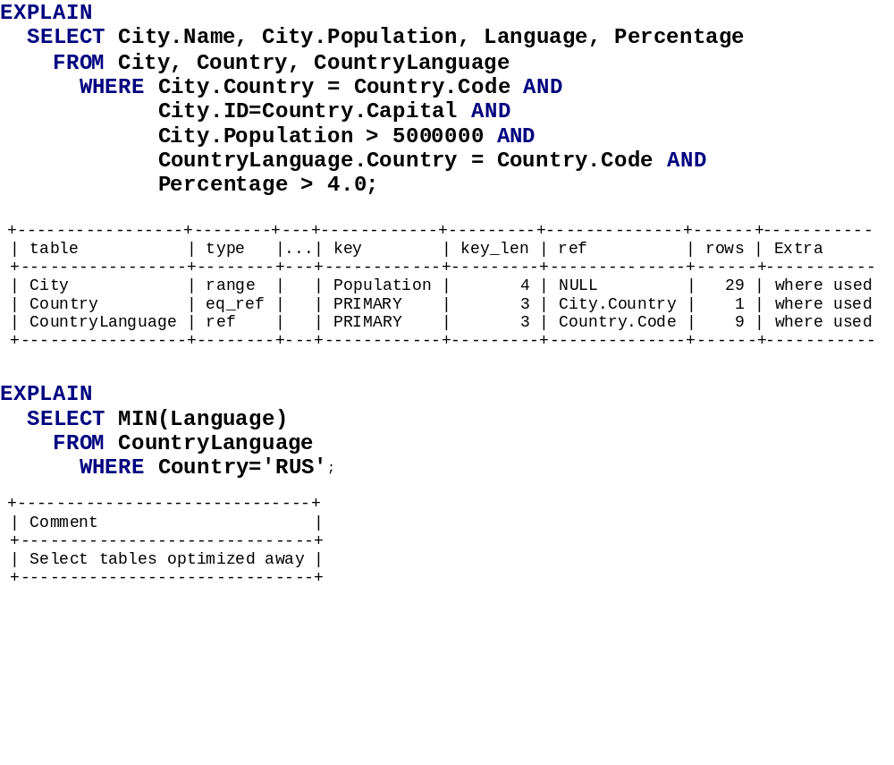

Slide 32
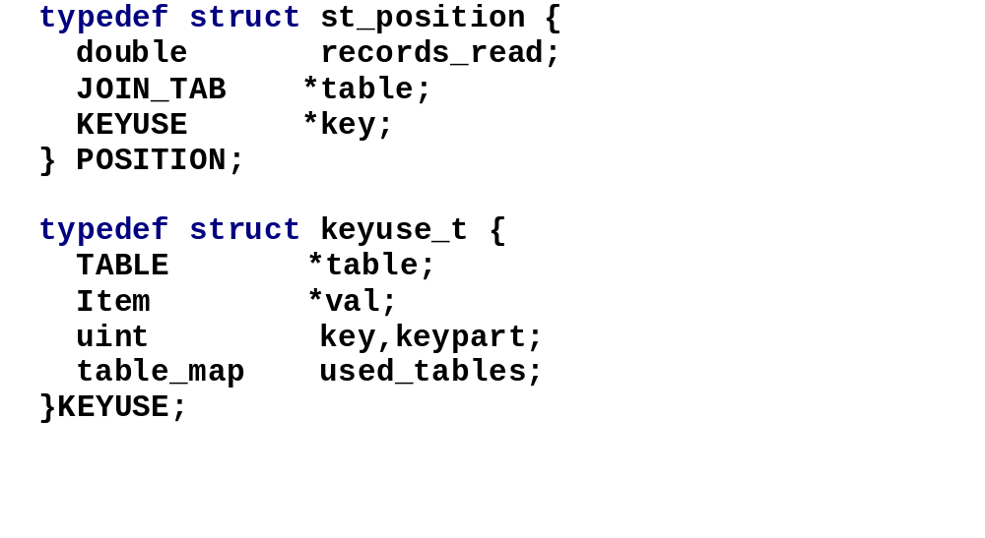

Slide 33
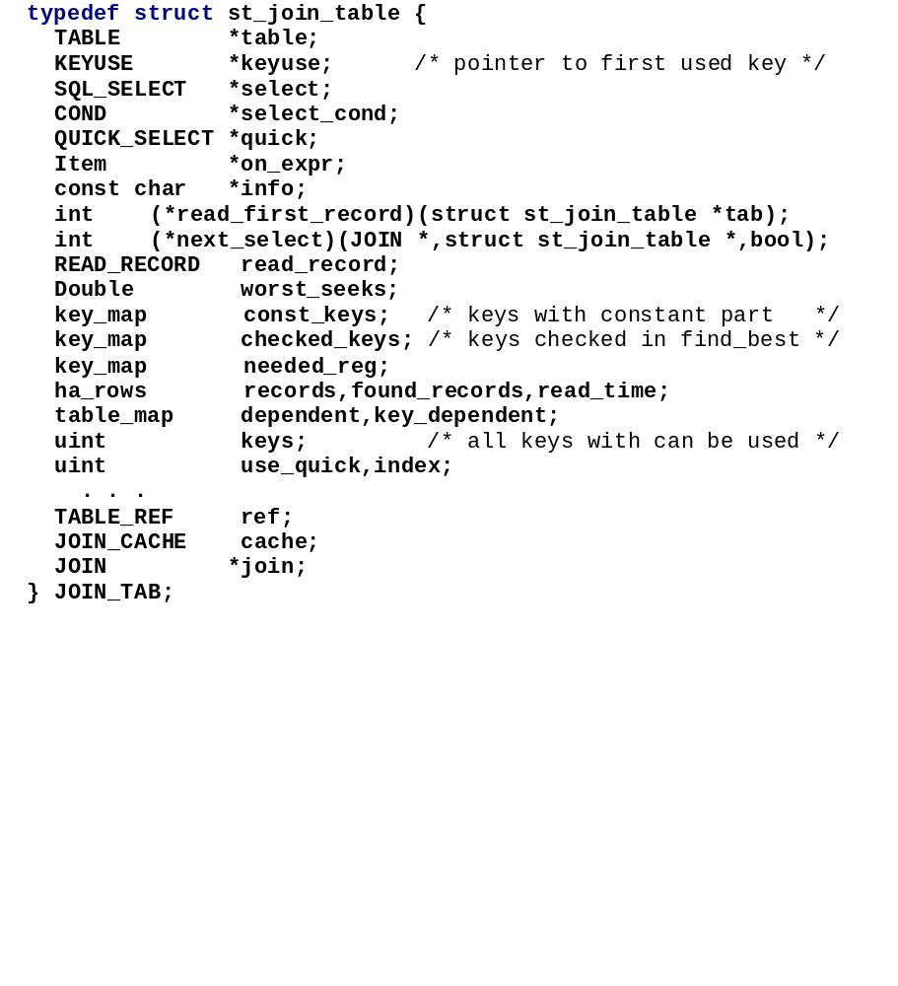

Slide 34
Landmark 3.
The Gorge of Range Analysis:
Extracting retrieval ranges from where conditions

Slide 35
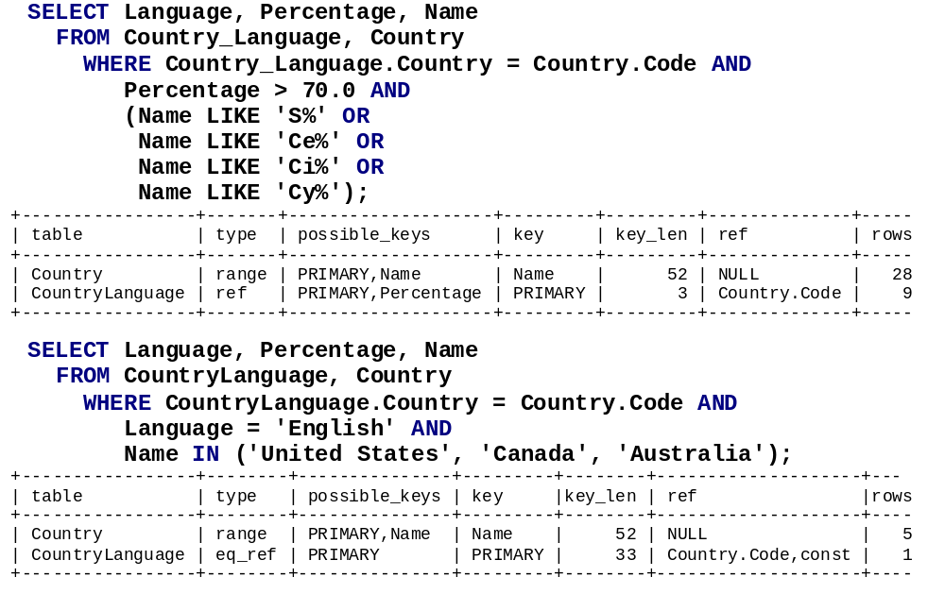

Slide 36
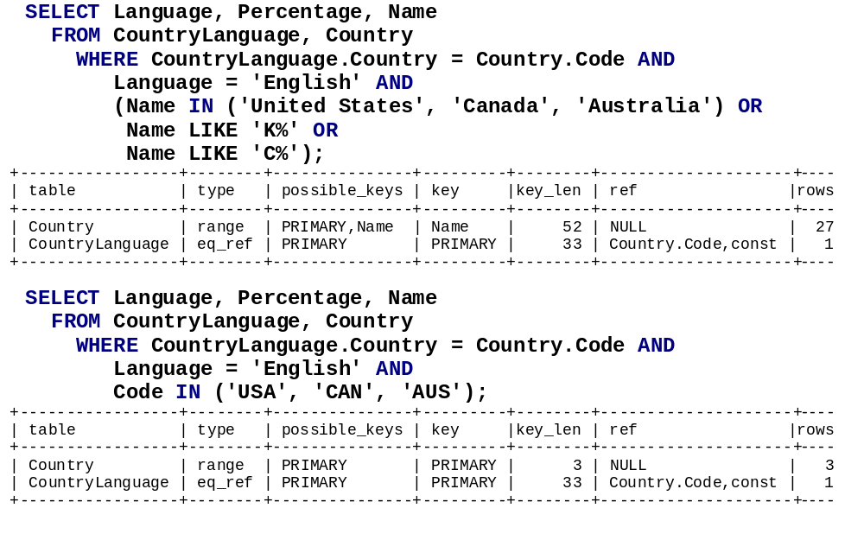

Slide 37
Landmark 4.
The Great Join Lakes:
Optimization for regular joins, for left outer joins
Optimization for queries with 'group by' and 'order by' clauses

Slide 38
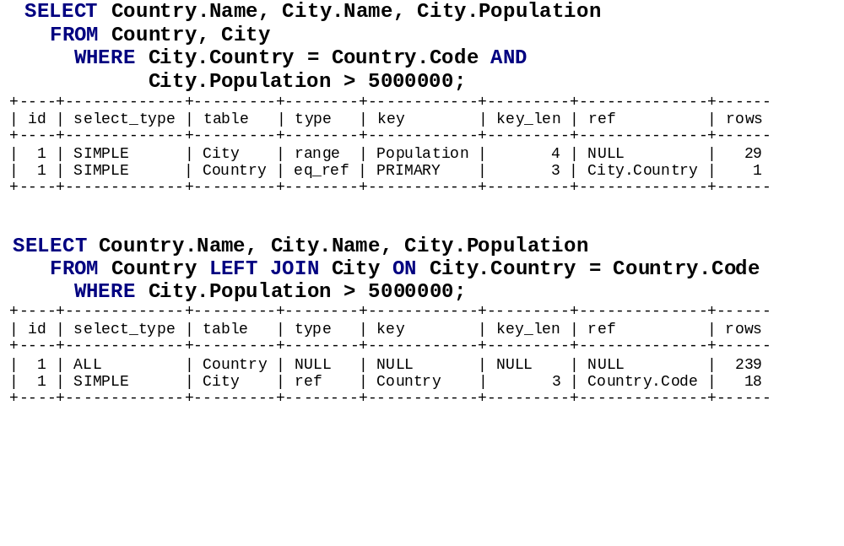

Slide 39
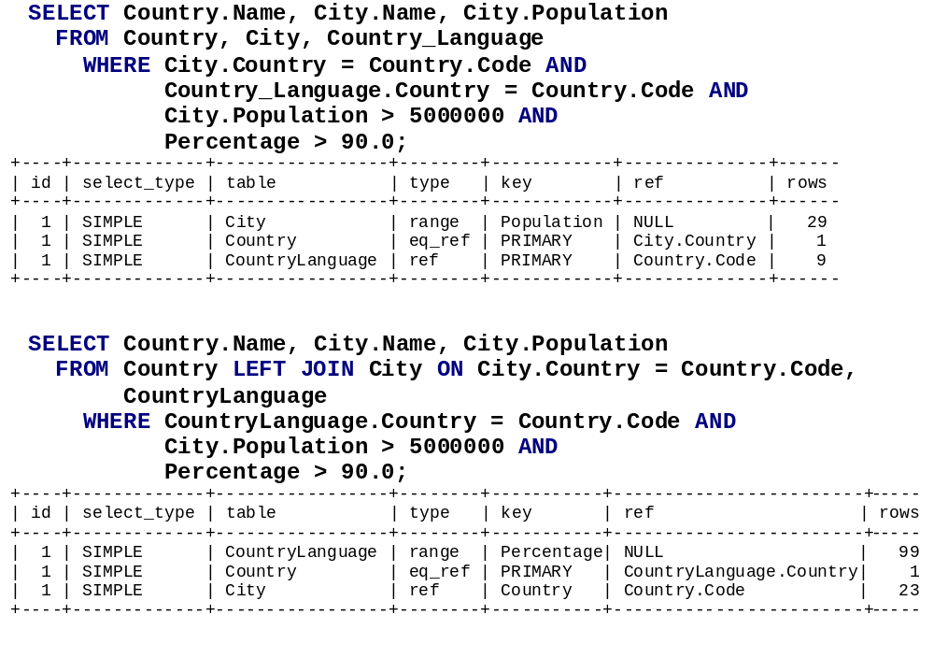

Slide 40
Landmark 5.
The Geyser of Sub-query Optimization:
Transformations for sub-queries
Optimization for sub-queries

Slide 41
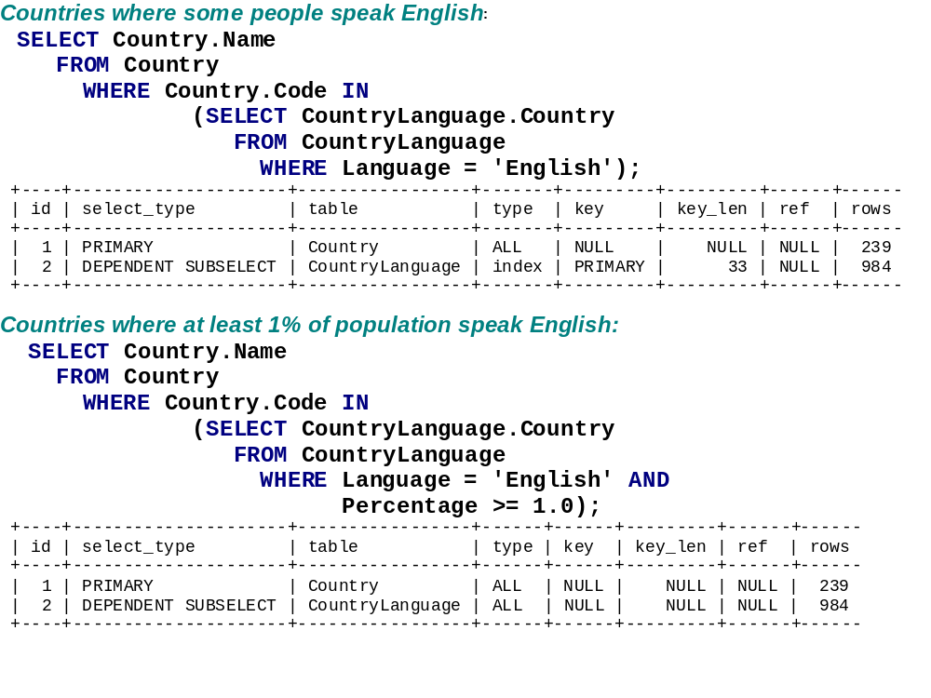

Slide 42
Avoiding Dangerous Caveats:
The limits of the current optimization
Where it works
What kind of queries are not optimized

Slide 43
The Great Database Wilderness:
Comparison with optimization performed by other database servers

Slide 44
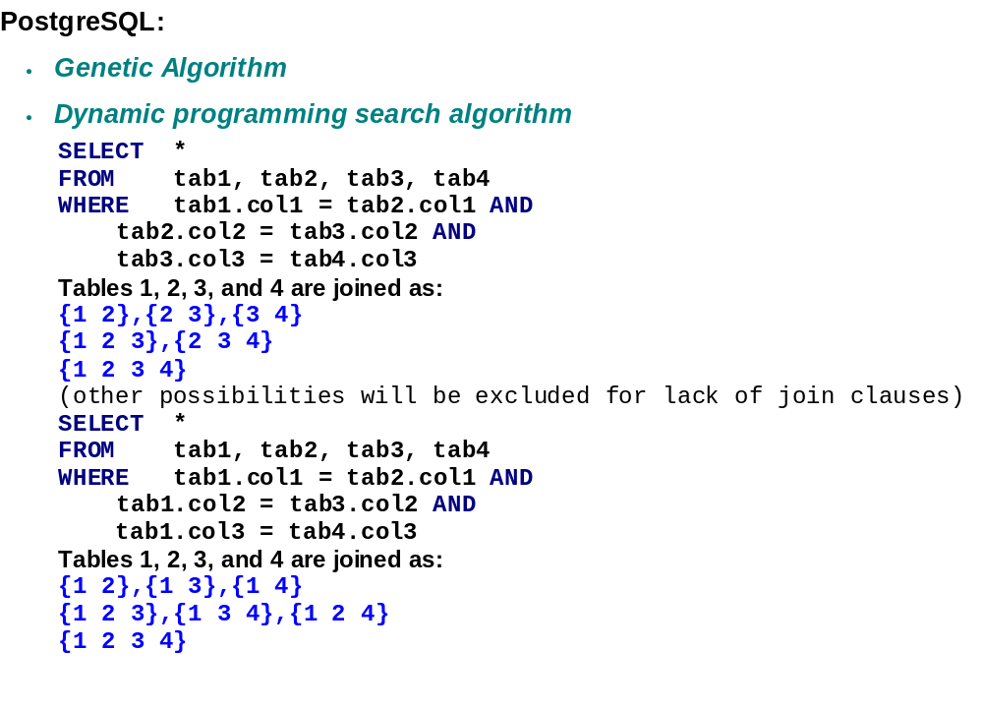

Slide 45
The MySQL Outback:
Short-term and long-term plans for MySQL optimizer

Slide 46
